Slide 1
Individual County – Trace Plots

Slide 2
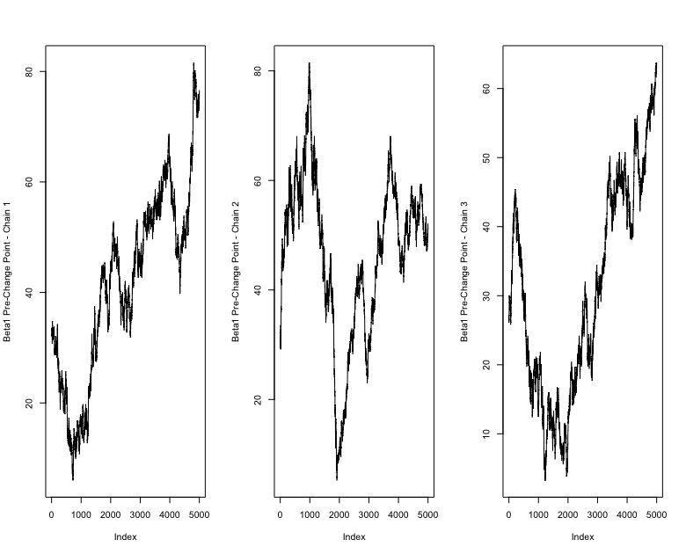
Albany County – Beta 1 Pre-Change Point

Slide 3
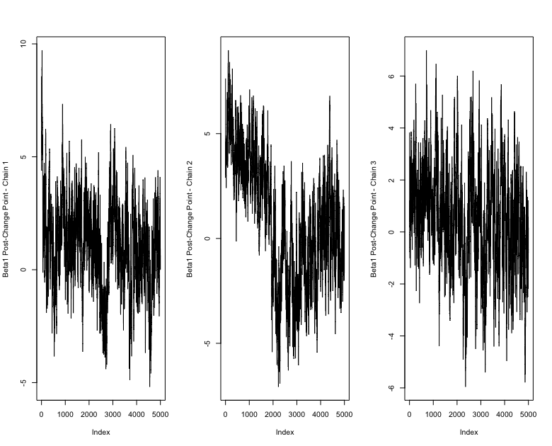
Albany County – Beta 1 Post-Change Point

Slide 4
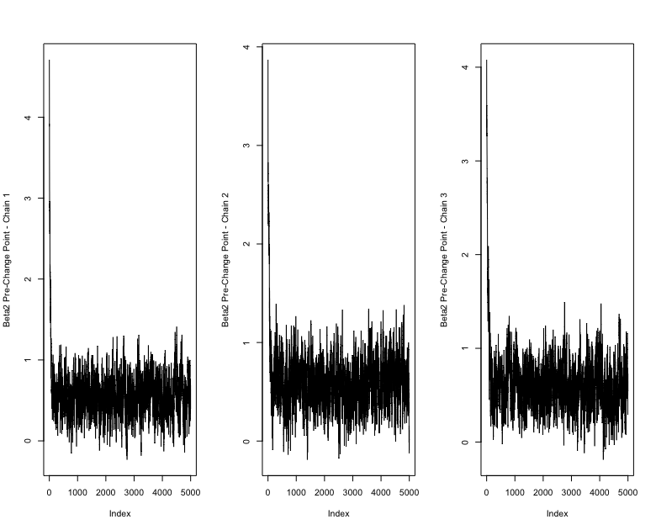
Albany County – Beta 2 Pre-Change Point

Slide 5
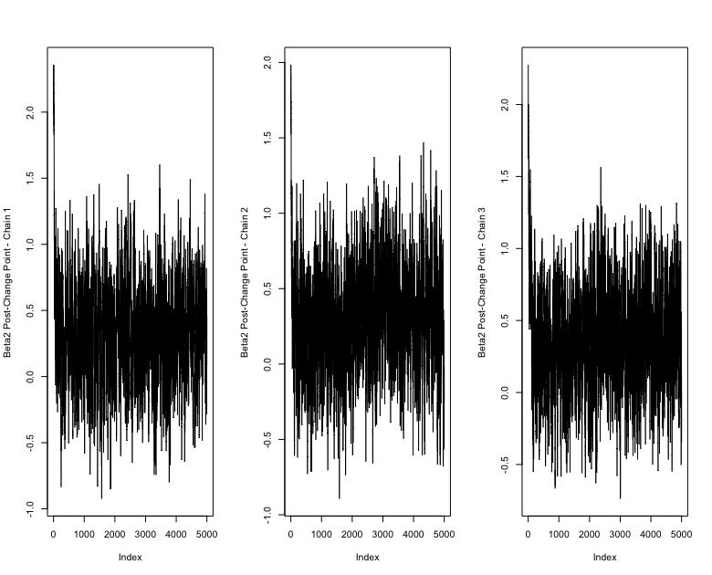
Albany County – Beta 2 Post-Change Point

Slide 6

Albany County – Beta 3 Pre-Change Point

Slide 7
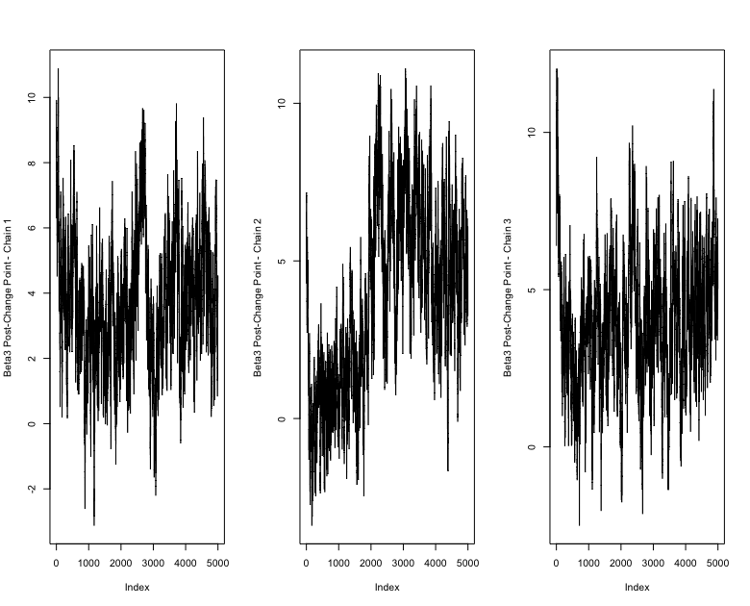
Albany County – Beta 3 Post-Change Point

